Slide 1
CHAPTER Income and
5 Substitution Effects

Slide 2
Demand Functions
The optimal levels of x₁,x₂,…,x_{n}
  Can be expressed as functions of all prices and income
  These can be expressed as n demand functions of the form:
    x₁* = d₁(p₁,p₂,…,p_{n},I)
    x₂* = d₂(p₁,p₂,…,p_{n},I)
    …
    x_{n}* = d_{n}(p₁,p₂,…,p_{n},I)

Slide 3
Demand Functions
For only two goods (x and y):
x* = x(p_{x},p_{y},I)
y* = y(p_{x},p_{y},I)
Prices and income are exogenous
  The individual has no control over these parameters

Slide 4
Demand Functions
Homogeneity
  Double all prices and income - the optimal quantities demanded would remain unchanged
  The budget constraint is unchanged
x_{i}* = x_{i}(p₁,p₂,…,p_{n},I) = x_{i}(tp₁,tp₂,…,tp_{n},tI)
  Individual demand functions are homogeneous of degree zero in all prices and income

Slide 5
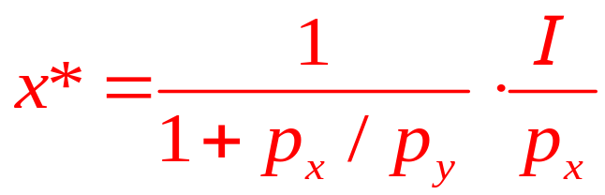
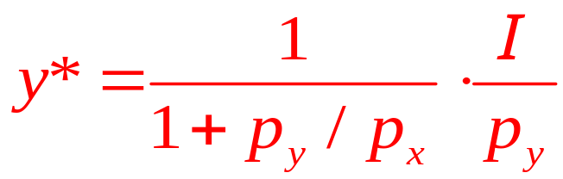
5.1 Homogeneity
Cobb-Douglas utility function:
  utility = U(x,y) = x^{0.3}y^{0.7}
  The demand functions are: x*=0.3I/p_{x} and y*=0.7I/p_{y}
  Exhibit homogeneity
CES utility function:
  utility = U(x,y) = x^{0.5} + y^{0.5}
  The demand functions are:
  Exhibit homogeneity

Slide 6
Changes in Income
An increase in income
  Will cause the budget constraint out in a parallel fashion
  p_{x}/p_{y} does not change
    The MRS will stay constant as the individual moves to higher levels of satisfaction

Slide 7
Changes in Income
Normal good
  Over some range of income
  A good x_{i} for which ∂x_{i}/∂I ≥ 0 over that range of income
Inferior good
  Over some range of income
  A good x_{i} for which ∂x_{i}/∂I < 0 over that range of income

Slide 8
5.1 Effect of an Increase in Income on the Quantities of x and y Chosen
Quantity of y
I₃
I₂
y₃
y₂
I₁
U₃
y₁
U₂
U₁
x₁
x₂
x₃
Quantity of x
As income increases from I₁ to I₂ to I₃, the optimal (utility-maximizing) choices of x and y are shown by the successively higher points of tangency. Observe that the budget constraint shifts in a parallel way because its slope (given by -p_{x}/p_{y}) does not change.

Slide 9
5.2 An Indifference Curve Map Exhibiting Inferiority
Quantity of y
y₃
I₂
U₃
y₂
I₃
I₁
U₂
y₁
U₁
z₃
z₂
z₁
Quantity of z
In this diagram, good z is inferior because the quantity purchased decreases as income increases. Here, y is a normal good (as it must be if there are only two goods available), and purchases of y increase as total expenditures increase.

Slide 10
Changes in a Good’s Price
A change in the price of a good
  Alters the slope of the budget constraint
  Changes the MRS at the consumer’s utility-maximizing choices
  Two effects come into play
    Substitution effect
    Income effect

Slide 11
Changes in a Good’s Price
Substitution effect of a price change
  Even if the individual were to stay on the same indifference curve
  Consumption patterns would be allocated so as to equate the MRS to the new price ratio

Slide 12
Changes in a Good’s Price
Income effect of a price change
  Arises because a price change necessarily changes an individual’s ‘‘real’’ income
  The individual cannot stay on the initial indifference curve and must move to a new one

Slide 13
5.3 Demonstration of Income and Substitution Effects of a Decrease in the Price of x
When the price of x decreases from p¹_{x} to p²_{x} , the utility-maximizing choice shifts from x*,y* to x**,y**. This movement can be broken down into two analytically different effects: first, the substitution effect, involving a movement along the initial indifference curve to point B, where the MRS is equal to the new price ratio; and second, the income effect, entailing a movement to a higher level of utility because real income has increased. In the diagram, both the substitution and income effects cause more x to be bought when its price decreases. Notice that point I/p_{y} is the same as before the price change; this is because p_{y} has not changed. Therefore, point I/p_{y} appears on both the old and new budget constraints.
Quantity of y
I/p_{y}
y**
y*
B
U₂
I=p²_{x}x+p_{y}y
U₁
I=p¹_{x}x+p_{y}y
x*
x_{B}
x**
Quantity of x
Substitution effect
Income effect
Total increase in x

Slide 14
5.4 Demonstration of Income and Substitution Effects of an Increase in the Price of x
When the price of x increases, the budget constraint shifts inward. The movement from the initial utility-maximizing point (x*,y*) to the new point (x**,y**) can be analyzed as two separate effects. The substitution effect would be depicted as a movement to point B on the initial indifference curve (U₂). The price increase, however, would create a loss of purchasing power and a consequent movement to a lower indifference curve. This is the income effect. In the diagram, both the income and substitution effects cause the quantity of x to decrease as a result of the increase in its price. Again, the point I/p_{y} is not affected by the change in the price of x.
Quantity of y
I/p_{y}
B
y*
y**
U₂
I=p¹_{x}x+p_{y}y
U₁
I=p²_{x}x+p_{y}y
x*
x_{B}
x**
Quantity of x
Income effect
Substitution effect
Total increase in x

Slide 15
Changes in a Good’s Price
If a good is normal, substitution and income effects reinforce one another
  When p ↓:
    Substitution effect ⇒ quantity demanded ↑
    Income effect ⇒ quantity demanded ↑
  When p ↑:
    Substitution effect ⇒ quantity demanded ↓
    Income effect ⇒ quantity demanded ↓

Slide 16
Changes in a Good’s Price
For normal goods, a fall in price leads to an increase in quantity demanded
  Substitution effect
    Purchase more - as the individual moves along an indifference curve
  Income effect
    Purchase more - because the resulting rise in purchasing power allows the individual to move to a higher indifference curve

Slide 17
Changes in a Good’s Price
For normal goods, a rise in price leads to a decline in quantity demanded
  Substitution effect
    Purchase less - as the individual moves along an indifference curve
  Income effect
    Purchase less - because the resulting drop in purchasing power moves the individual to a lower indifference curve

Slide 18
Changes in a Good’s Price
If a good is inferior, substitution and income effects move in opposite directions
  When p ↓:
    Substitution effect ⇒ quantity demanded ↑
    Income effect ⇒ quantity demanded ↓
  When p ↑:
    Substitution effect ⇒ quantity demanded ↓
    Income effect ⇒ quantity demanded ↑

Slide 19
Changes in a Good’s Price
Giffen’s paradox
  If the income effect of a price change is strong enough, there could be a positive relationship between price and quantity demanded
    An increase in price leads to a drop in real income
    Since the good is inferior, a drop in income causes quantity demanded to rise

Slide 20
Changes in a Good’s Price
For inferior goods, no definite prediction can be made for changes in price
  The substitution effect and income effect move in opposite directions
  If the income effect outweighs the substitution effect, we have a case of Giffen’s paradox

Slide 21
The Individual’s Demand Curve
An individual’s demand for x
  Depends on preferences, all prices, and income: x* = x(p_{x},p_{y},I)
  It may be convenient to graph it assuming that income and the price of y (p_{y}) are held constant

Slide 22
5.5 Construction of an Individual’s Demand Curve
Quantity of y
p_{x}
I / p_{y}
I = p_{x}’’’x + p_{y}y
p_{x}’
p_{x}’’
p_{x}’’’
U₃
x
U₁
U₂
x’
x”
x”’
Quantity of x
x’
x’’
x’’’
Quantity of x
I = p_{x}’x + p_{y}y
I = p_{x}’’x + p_{y}y
In (a), the individual’s utility-maximizing choices of x and y are shown for three different prices of x(p’_{x}, p”_{x}, and p’”_{x}). In (b), this relationship between p_{x} and x is used to construct the demand curve for x. The demand curve is drawn on the assumption that p_{y}, I, and preferences remain constant as p_{x} varies.

Slide 23
The Individual’s Demand Curve
An individual demand curve
  Shows the relationship between the price of a good and the quantity of that good purchased by an individual
  Assuming that all other determinants of demand are held constant

Slide 24
The Individual’s Demand Curve
Shifts in the demand curve
  Three factors are held constant when a demand curve is derived
    Income
    Prices of other goods (p_{y})
    The individual’s preferences
  If any of these factors change, the demand curve will shift to a new position

Slide 25
The Individual’s Demand Curve
A change in quantity demanded
  Movement along a given demand curve
    Caused by a change in the price of the good
A change in demand
  Shift in the demand curve
    Caused by changes in income, prices of other goods, or preferences

Slide 26
5.2 Demand Functions and Demand Curves
Cobb-Douglas
  The demand functions: x=0.3I/p_{x} and y=0.7I/p_{y}
  For I=$100: x=30/p_{x} and y=70/p_{y}
    Or: p_{x}x=30 and p_{y}y=70
  The demand curves for these two goods are simple hyperbolas
    An increase in income would shift both of the demand curves outward
    The demand curve for x is not shifted by changes in p_{y} and vice versa

Slide 27
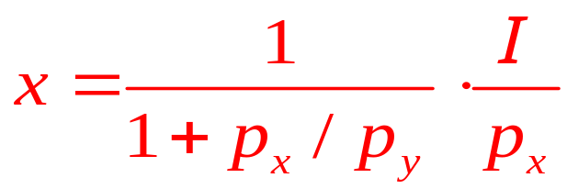
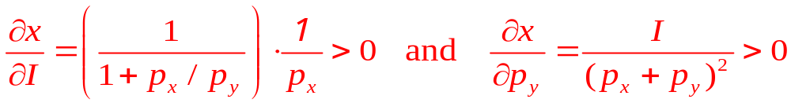
5.2 Demand Functions and Demand Curves
CES
  For good x:
  For I=$100 and p_{y}=1: x=100/(p_{x}²+p_{x})
  General hyperbolic relationship between price and quantity consumed
    Relatively flatter curve because substitution effects are larger
  Increases in I or p_{y} would shift the demand curve for good x outward because:

Slide 28
Compensated (HICKSIAN) Demand
Curves and Functions
Actual level of utility
  Varies along the demand curve
As the price of x falls, the individual moves to higher indifference curves
  Assumption: nominal income is held constant as the demand curve is derived
  “Real” income rises as the price of x falls

Slide 29
Compensated (HICKSIAN) Demand
Curves and Functions
Alternative approach
  Hold real income (or utility) constant while examining reactions to changes in p_{x}
    The effects of the price change are “compensated” so as to force the individual to remain on the same indifference curve
    Reactions to price changes include only substitution effects

Slide 30
Compensated (HICKSIAN) Demand
Curves and Functions
Compensated (Hicksian) demand curve
  Shows the relationship between the price of a good and the quantity purchased
    Assuming that other prices and utility are held constant
  Is a two-dimensional representation of the compensated demand function
x* = x^{c}(p_{x},p_{y},U)

Slide 31
5.6 Construction of a Compensated Demand Curve
Quantity of y
p_{x}
U₂
Slope = p’_{x}/p_{y}
Slope = p”_{x}/p_{y}
p_{x}’
Slope = p”’_{x}/p_{y}
p_{x}’’
p_{x}’’’
x^{c}
x’
x”
x”’
Quantity of x
x’
x’’
x’’’
Quantity of x
The curve x^{c} shows how the quantity of x demanded changes when p_{x} changes, holding p_{y} and utility constant. That is, the individual’s income is ‘‘compensated’’ to keep utility constant. Hence x^{c} reflects only substitution effects of changing prices.

Slide 32
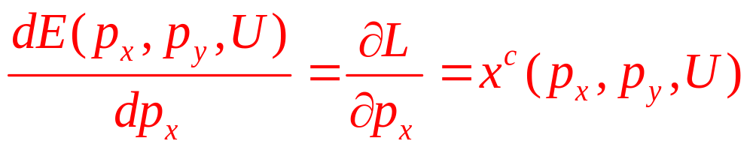
Compensated (HICKSIAN) Demand
Curves and Functions
Shephard’s lemma
  Compensated demand function for a good
    Can always be found from the expenditure function by differentiation with respect to good’s price
    Lagrangian: ℒ =p_{x}x+p_{y}y+λ[U(x,y)-Ū]
    Yields the expenditure function: E(p_{x},p_{y},U)
    Envelope theorem:

Slide 33
Compensated (HICKSIAN) Demand
Curves and Functions
Relationship between compensated and uncompensated demand curves
  Normal good
    Compensated demand curve is less responsive to price changes than is the uncompensated demand curve
      Uncompensated demand curve reflects both income and substitution effects
      Compensated demand curve reflects only substitution effects

Slide 34
5.7 Comparison of Compensated and Uncompensated Demand Curves
p_{x}
p_{x}’
p_{x}’’
p_{x}’’’
x(p_{x},p_{y},I)
x^{c}(p_{x},p_{y},U)
x’
x*
x’’
x**
x’’’
Quantity of x
The compensated (x^{c}) and uncompensated (x) demand curves intersect at p”_{x} because x” is demanded under each concept. For prices above p”_{x}, the individual’s purchasing power must be increased with the compensated demand curve; thus, more x is demanded than with the uncompensated curve. For prices below p”_{x}, purchasing power must be reduced for the compensated curve; therefore, less x is demanded than with the uncompensated curve. The standard demand curve is more price-responsive because it incorporates both substitution and income effects, whereas the curve x^{c} reflects only substitution effects.

Slide 35
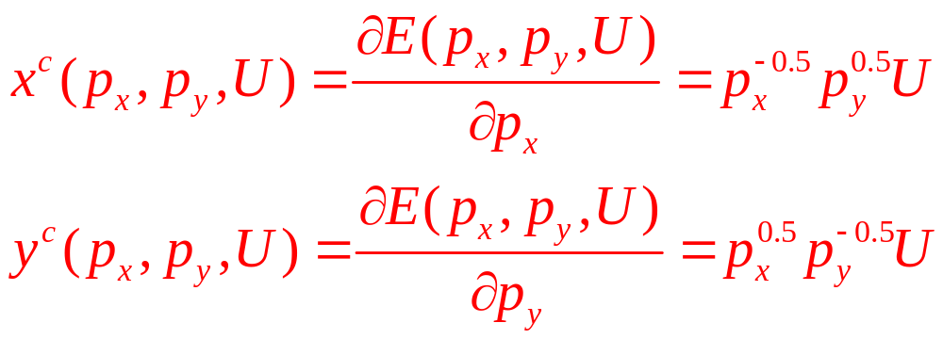
5.3 Compensated Demand Functions
The utility is: utility = U(x,y) = x^{0.5}y^{0.5}
  The Marshallian demand functions:
  x(p_{x},p_{y},I) = 0.5I/p_{x} and y(p_{x},p_{y},I) = 0.5I/p_{y}
  The expenditure function: E(p_{x},p_{y}, U)=2p_{x}^{0.5}p_{y}^{0.5}U
  Use Shephard’s lemma to calculate the compensated demand functions as

Slide 36
A Mathematical Development of Response to Price Changes
Use the utility-maximization model
  To learn something about how the demand for good x changes when p_{x} changes
  Calculate ∂x/∂p_{x}
Direct approach
  Comparative static methods by differentiating the three first order conditions for a maximum with respect to p_{x}
    Cumbersome and provides little economic insight

Slide 37
A Mathematical Development of Response to Price Changes
Indirect approach
  Assume there are only two goods, x and y
  Focus on the compensated demand function, x^{c}(p_{x},p_{y},U)
  And its relationship to the ordinary demand function, x(p_{x},p_{y},I)
  x^{c} (p_{x},p_{y},U) = x [p_{x},p_{y},E(p_{x},p_{y},U)]

Slide 38
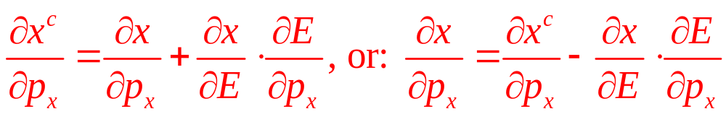
A Mathematical Development of Response to Price Changes
Indirect approach
  The substitution effect
    The first term: the slope of the compensated demand curve
  The income effect
    The second term: measures the way in which changes in p_{x} affect the demand for x through changes in purchasing power

Slide 39
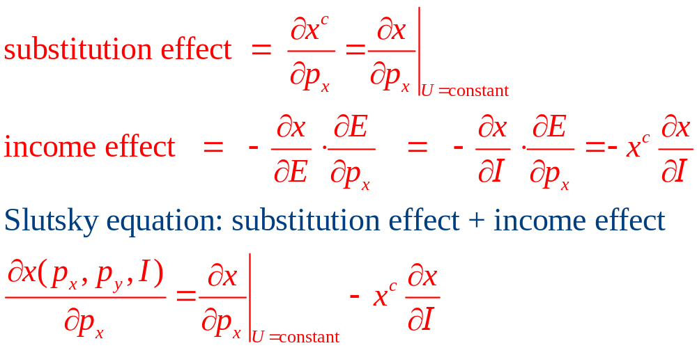
A Mathematical Development of Response to Price Changes
The Slutsky equation

Slide 40
A Mathematical Development of Response to Price Changes
The Slutsky equation
  The substitution effect
    Always negative as long as MRS is diminishing
    The slope of the compensated demand curve must be negative
  The income effect
    If x is a normal good, then ∂x/∂I > 0
      The entire income effect is negative
    If x is an inferior good, then ∂x/∂I < 0
      The entire income effect is positive

Slide 41
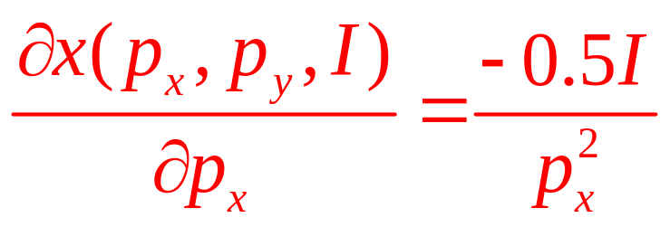
5.4 A Slutsky Decomposition
Marshallian demand function for good x
x(p_{x},p_{y},I) = 0.5I/p_{x}
Compensated demand function for this good
x^{c}(p_{x},p_{y}, U)=p_{x}^{-0.5}p_{y}^{0.5}U
Total effect of a price change on Marshallian demand

Slide 42
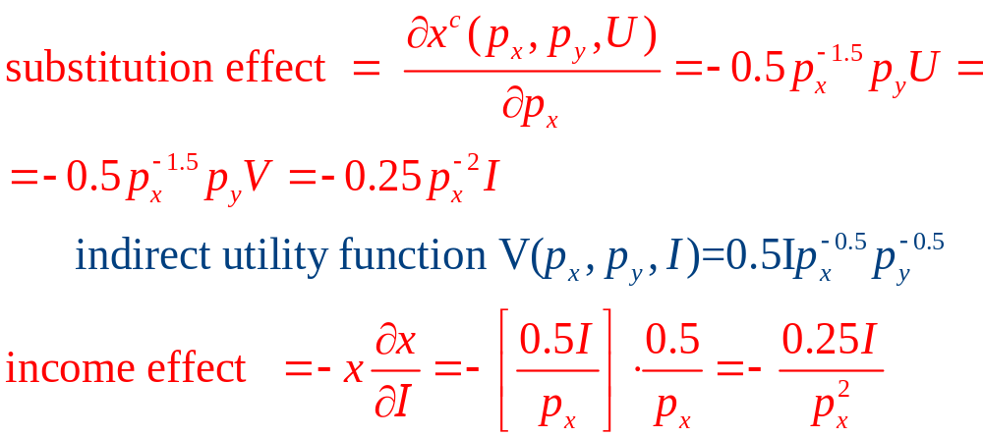
5.4 A Slutsky Decomposition

Slide 43
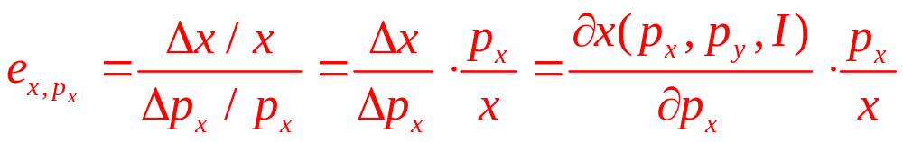
Marshallian Demand Elasticities
Marshallian demand elasticities
  Marshallian demand function: x(p_{x},p_{y},I)
1. Price elasticity of demand, e_{x}, _{px}
  Measures the proportionate change in quantity demanded
    In response to a proportionate change in a good’s own price

Slide 44
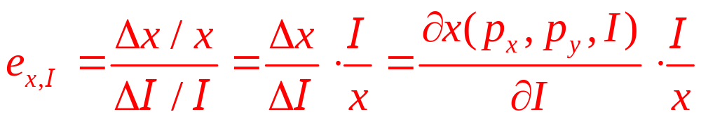
Marshallian Demand Elasticities
2. Income elasticity of demand, e_{x,I}
  Measures the proportionate change in quantity demanded
    In response to a proportionate change in income

Slide 45
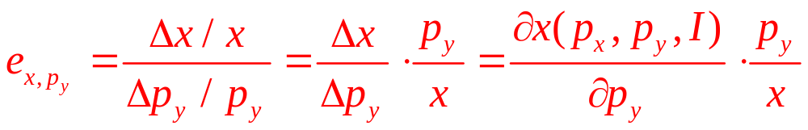
Marshallian Demand Elasticities
3. Cross-price elasticity of demand, e_{x,py}
  Measures the proportionate change in quantity of x demanded
    In response to a proportionate change in the price of some other good (y)

Slide 46
Price elasticity of demand
The own price elasticity of demand is always negative
  The only exception is Giffen’s paradox
The size of the elasticity is important
  If e_{x,px} < -1, demand is elastic
  If e_{x,px} > -1, demand is inelastic
  If e_{x,px} = -1, demand is unit elastic

Slide 47
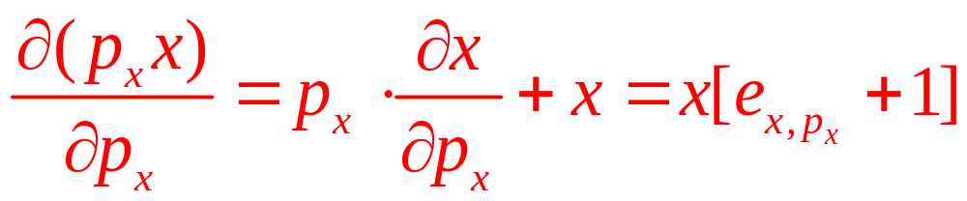
Price Elasticity of Demand
Total spending on x = p_{x}x
If 0 > e_{x,px} > -1, demand is inelastic
  Price and total spending move in the same direction
If e_{x,px} < -1, demand is elastic
  Price and total spending move in opposite directions

Slide 48
Compensated Price Elasticities
Compensated price elasticities
  Compensated demand function, x^{c}(p_{x},p_{y},U)
Compensated own-price elasticity of demand, e_{xc,px}
  Measures the proportionate compensated change in quantity demanded
    In response to a proportionate change in a good’s own price

Slide 49
Compensated Price Elasticities
2. Compensated cross-price elasticity of demand, e_{xc,py}
  Measures the proportionate compensated change in quantity of x demanded
    In response to a proportionate change in the price of another good, y

Slide 50
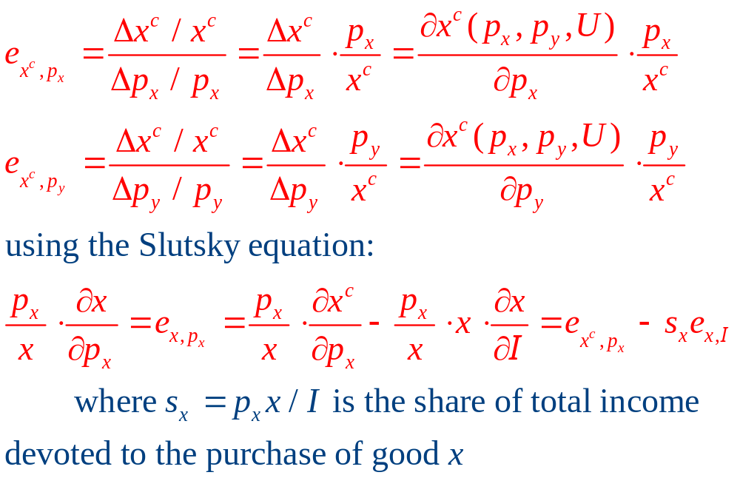
Compensated Price Elasticities

Slide 51
Compensated Price Elasticities
The Slutsky equation shows
  That the compensated and uncompensated price elasticities will be similar if
    The share of income devoted to x is small
    The income elasticity of x is small

Slide 52
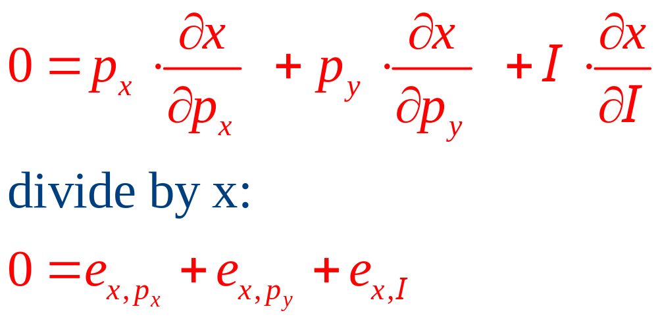
Relationships among Demand Elasticities
Homogeneity
  Demand functions are homogeneous of degree zero in all prices and income
  Euler’s theorem for homogenous functions shows that

Slide 53
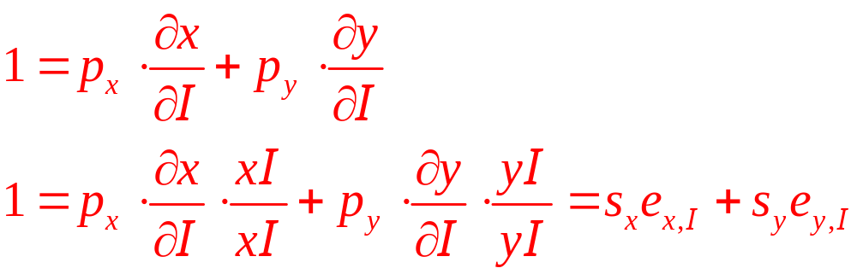
Relationships among Demand Elasticities
Engel aggregation
  Engel’s law: income elasticity of demand for food items is <1
    Income elasticity of demand for all nonfood items must be >1
  Differentiate the budget constraint with respect to income

Slide 54
Relationships among Demand Elasticities
Cournot aggregation
  The size of the cross-price effect of a change in p_{x} on the quantity of y consumed is restricted because of the budget constraint
  Differentiate the budget constraint with respect to p_{x}

Slide 55
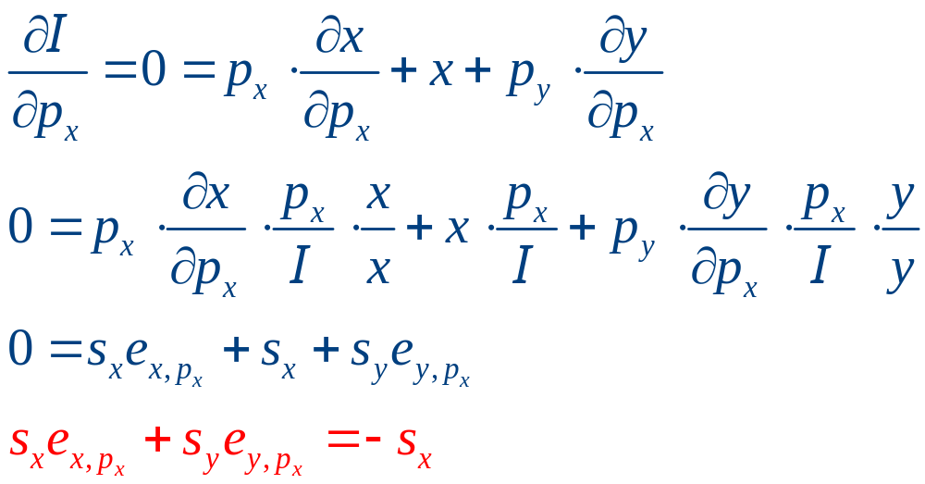
Relationships among Demand Elasticities
Cournot aggregation

Slide 56
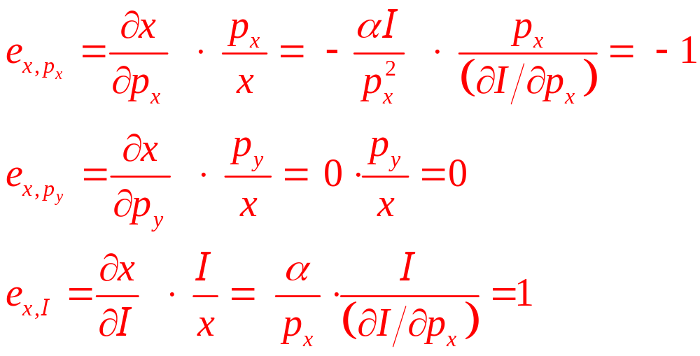
5.5 Demand Elasticities: The Importance of Substitution Effects
Cobb-Douglas (σ=1): U(x,y)=x^{α}y^{β}, α+β=1
  Demand functions: x(p_{x},p_{y},I)=αI/p_{x}, and y(p_{x},p_{y},I)=βI/p_{y}=(1- α)I/p_{y}
  Elasticities:

Slide 57
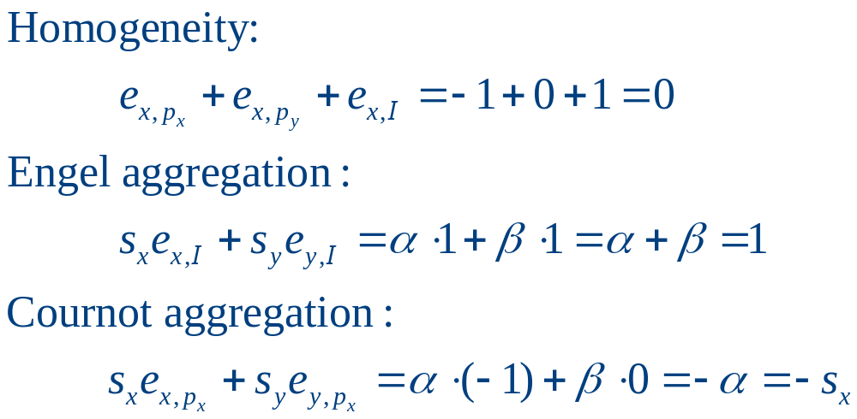
5.5 Demand Elasticities: The Importance of Substitution Effects
Cobb-Douglas:
  Because s_{x} = α and s_{y} = β

Slide 58
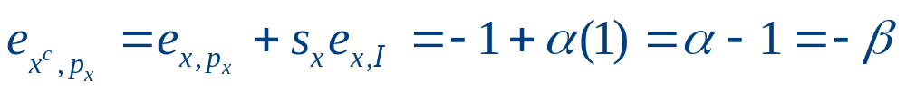
5.5 Demand Elasticities: The Importance of Substitution Effects
Cobb-Douglas:
  Using the Slutsky equation in elasticity form to derive the compensated price elasticity:

Slide 59
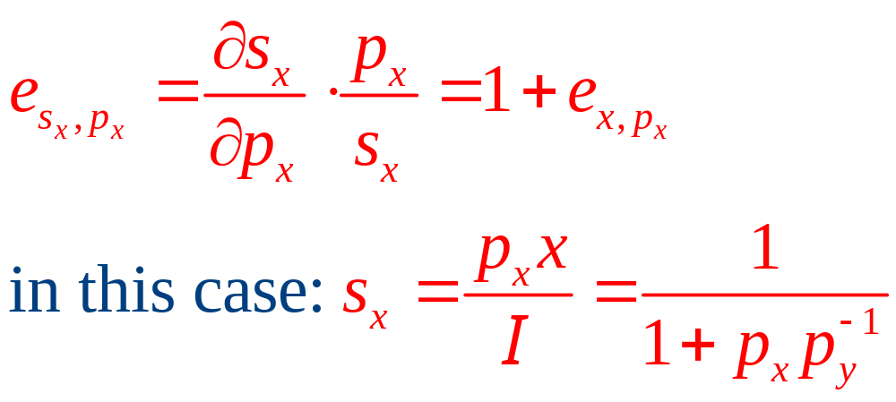
5.5 Demand Elasticities: The Importance of Substitution Effects
2. CES utility function (σ = 2, δ = 5):
U(x,y) = x^{0.5} + y^{0.5}
  The demand functions for x and y:
  x(p_{x},p_{y},I)=I/p_{x}(1+ p_{x}p_{y}⁻¹); y(p_{x},p_{y},I) =I/p_{x}(1+ p_{x}⁻¹p_{y})
  We will use the “share elasticity” to derive the own price elasticity

Slide 60
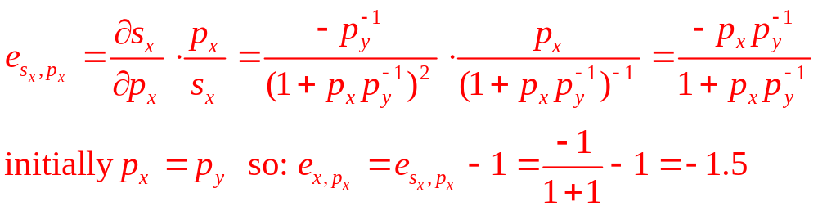
5.5 Demand Elasticities: The Importance of Substitution Effects
2. CES utility function (σ = 2, δ = 5)
  The share elasticity is given by

Slide 61
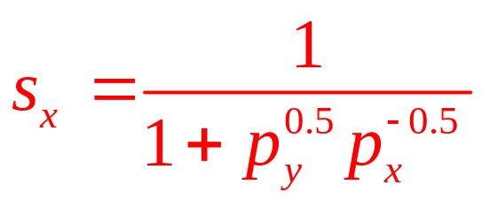
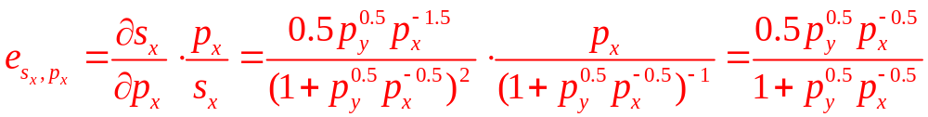
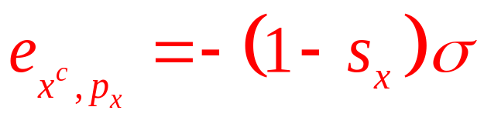
5.5 Demand Elasticities: The Importance of Substitution Effects
3. CES utility function (σ = 0.5, δ = -1):
U(x,y) = – x ⁻¹ – y ⁻¹
  The share of good x is:
  The share elasticity is:
  In general, the compensated price elasticity is

Slide 62
Consumer Surplus
Measure the change in welfare
  That an individual experiences if the price of good x increases from p⁰_{x} to p¹_{x}
  To reach U₀
    Expenditure at p⁰_{x}: E(p⁰_{x},p_{y},U₀)
    Expenditure at p¹_{x}: E(p¹_{x},p_{y},U₀)
  To compensate for the price increase – compensating variation (CV) of:
  CV = E(p_{x}¹,p_{y},U₀) - E(p_{x}⁰,p_{y},U₀)

Slide 63
5.8 Showing Compensating Variation
(a) Indifference curve map
Spending on
other goods ($)
E(p¹_{x},p_{y},U₀)
E(p¹_{x},p_{y},U₀)
CV
E(p⁰_{x},p_{y},U₀)
y₁
y₂
y₀
U₀
U₁
E(p⁰_{x},p_{y},U₀)
x₂
x₁
x₀
Quantity of x
If the price of x increases from p⁰_{x} to p¹_{x}, this person needs extra expenditures of CV to remain on the U₀ indifference curve. Integration shows that CV can also be represented by the shaded area below the compensated demand curve in panel (b).

Slide 64
5.8 Showing Compensating Variation
(b) Compensated demand curve
Price
p²_{x}
p¹_{x}
B
A
p⁰_{x}
x^{c}(p_{x},…,U₀)
x₁
x₀
Quantity of x
If the price of x increases from p⁰_{x} to p¹_{x}, this person needs extra expenditures of CV to remain on the U₀ indifference curve. Integration shows that CV can also be represented by the shaded area below the compensated demand curve in panel (b).

Slide 65
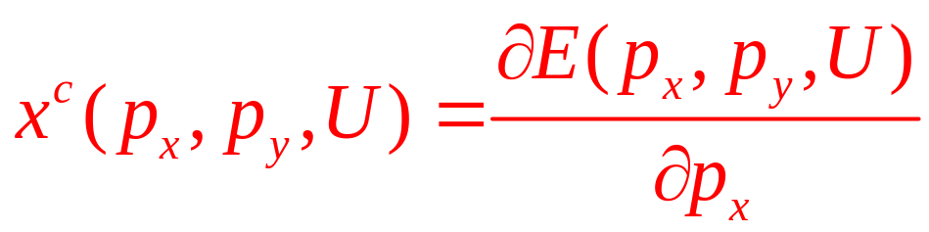
Consumer Surplus
Using the compensated demand curve to show CV
  The derivative of the expenditure function with respect to p_{x} is the compensated demand function

Slide 66
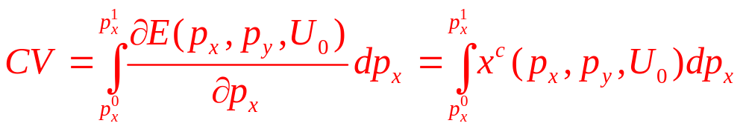
Consumer Surplus
Using the compensated demand curve to show CV
  The amount of CV required: integrate across a sequence of small increments to price from p_{x}⁰ to p_{x}
    This integral is the area to the left of the compensated demand curve between p_{x}⁰ and p_{x}¹

Slide 67
Consumer Surplus
Consumer surplus
  The area below the compensated demand curve and above the market price
  The extra benefit the person receives by being able to make market transactions at the prevailing market price

Slide 68
Consumer Surplus
Welfare changes and the Marshallian demand curve
Consumer surplus
  The area below the Marshallian demand curve and above price
    Shows what an individual would pay for the right to make voluntary transactions at this price
  Changes in consumer surplus measure the welfare effects of price changes

Slide 69
5.9 Welfare Effects of Price Changes and the Marshallian Demand Curve
p_{x}
B
p_{x}¹
C
A
p_{x}⁰
D
x(p_{x},…)
x^{c}(…,U₀)
x^{c}(…,U₁)
x₁
x₀
Quantity of x
The usual Marshallian (nominal income constant) demand curve for good x is x( p_{x},…). Further, x^{c}(…, U₀) and x^{c}(…, U₁) denote the compensated demand curves associated with the utility levels experienced when p⁰_{x} and p¹_{x}, respectively, prevail. The area to the left of x(p_{x}, …) between p⁰_{x} and p¹_{x} is bounded by the similar areas to the left of the compensated demand curves. Hence for small changes in price, the area to the left of the Marshallian demand curve is a good measure of welfare loss.

Slide 70
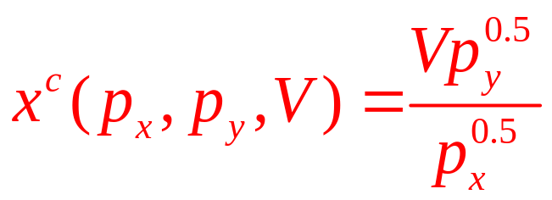
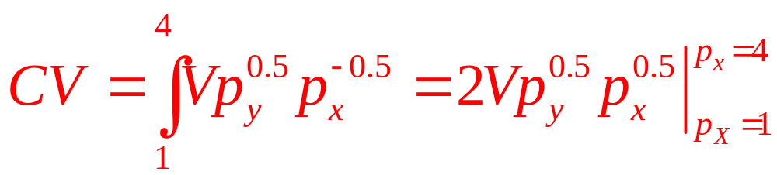
5.6 Welfare Loss from a Price Increase
Compensated demand function for x:
The welfare cost of a price increase
  From p_{x} = $1 to p_{x} = $4 is given by
  For V = 2 and p_{y} = 4: CV = 2⋅2⋅2⋅(4)^{0.5} – 2⋅2⋅2⋅(1)^{0.5} = 8
  If V=1 after the price increase: CV = 1⋅2⋅2⋅(4)^{0.5} – 1⋅2⋅2⋅(1)^{0.5} = 4

Slide 71
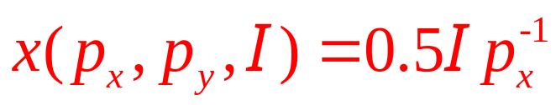
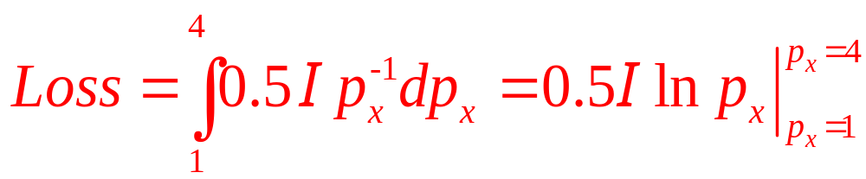
5.6 Welfare Loss from a Price Increase
Marshallian demand function:
  The welfare loss from a price increase from p_{x} = $1 to p_{x} = $4:
  If income (I) is equal to 8,
  Loss = 4 ln(4) - 4 ln(1) = 4 ln(4) = 4(1.39) = 5.55
    Compromise between the two amounts computed using the compensated demand functions

Slide 72
Revealed Preference and
The Substitution Effect
The theory of revealed preference
  Proposed by Paul Samuelson in the late 1940s
  Defines a principle of rationality based on observed behavior
  Uses it to approximate an individual’s utility function

Slide 73
Revealed Preference and The
Substitution Effect
Consider two bundles of goods: A and B
  If the individual can afford to purchase either bundle but chooses A, we say that A had been revealed preferred to B
  Under any other price-income arrangement, B can never be revealed preferred to A

Slide 74
5.10 Demonstration of the Principle of Rationality in the Theory of Revealed Preference
Quantity of y
A
C
y_{a}
B
y_{b}
I₂
I₁
I₃
Quantity of x
x_{a}
x_{b}
With income I₁ the individual can afford both points A and B. If A is selected, then A is revealed preferred to B. It would be irrational for B to be revealed preferred to A in some other price-income configuration.

Slide 75
Revealed Preference and the
Negativity of the Substitution Effect
Suppose that an individual is indifferent between two bundles: C and D
    p_{x}^{C},p_{y}^{C} - prices at which bundle C is chosen
    p_{x}^{D},p_{y}^{D} - prices at which bundle D is chosen
  When C is chosen, D must cost at least as much as C: p_{x}^{C}x_{C} + p_{y}^{C}y_{C} ≤ p_{x}^{C}x_{D} + p_{y}^{C}y_{D}
  When D is chosen, C must cost at least as much as D: p_{x}^{D}x_{D} + p_{y}^{D}y_{D} ≤ p_{x}^{D}x_{C} + p_{y}^{D}y_{C}

Slide 76
Revealed Preference and the
Negativity of the Substitution Effect
  Rearranging: p_{x}^{C}(x_{C} - x_{D}) + p_{y}^{C}(y_{C} -y_{D}) ≤ 0
and p_{x}^{D}(x_{D} - x_{C}) + p_{y}^{D}(y_{D} -y_{C}) ≤ 0
  Adding these together:
  (p_{x}^{C} – p_{x}^{D})(x_{C} - x_{D}) + (p_{y}^{C} – p_{y}^{D})(y_{C} - y_{D}) ≤ 0
  Suppose that only the price of x changes (p_{y}^{C} = p_{y}^{D}): (p_{x}^{C} – p_{x}^{D})(x_{C} - x_{D}) ≤ 0
    Price and quantity move in opposite direction when utility is held constant
    The substitution effect is negative

Slide 77
Demand concepts
Consumer price index (CPI)
  ‘‘Market basket’’ index of the cost of living
      Amounts that people consume of a set of goods in some base period
      Then use current price data to compute the changing price of this market basket
  Cost of the market basket
    In the base period (0), I₀=p_{x}⁰x₀+p_{y}⁰y₀
    In period 1, I₁=p_{x}¹x₀+p_{y}¹y₀
  Change in the cost of living: I₁/I₀

Slide 78
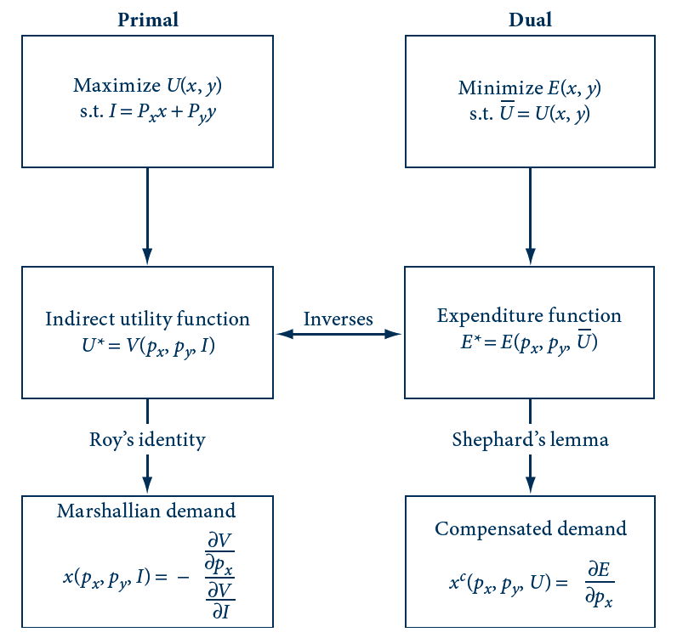
E5.1 Relationships among Demand Concepts

Slide 79
Expenditure functions & substitution bias
Market basket price indices
  Suffer from ‘‘substitution bias’’
  Do not permit individuals to make substitutions in the market basket
    In response to changes in relative prices
  Overstate the welfare losses that people incur from increasing prices

Slide 80
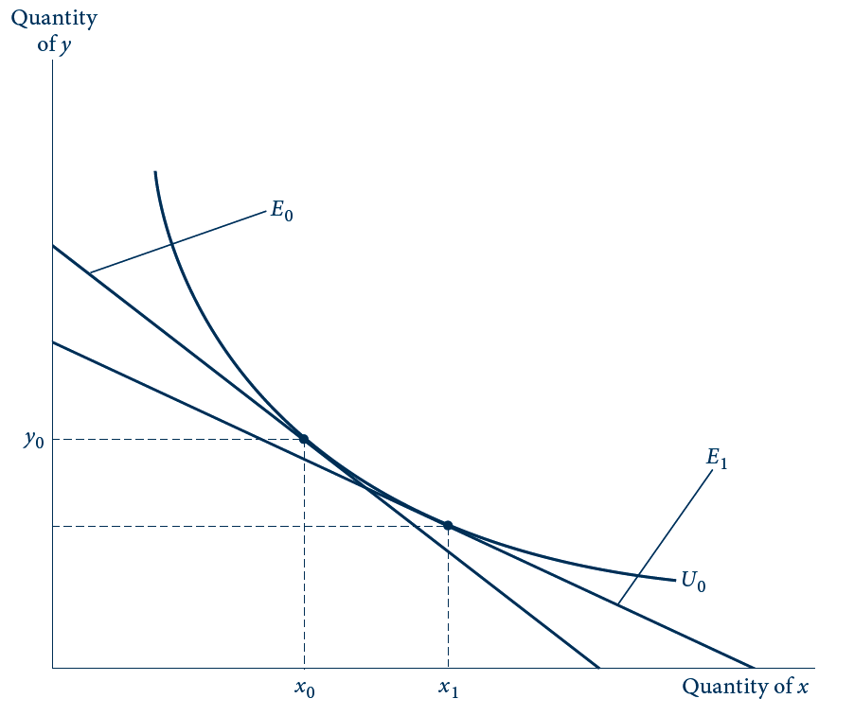
E5.2 Substitution Bias in the CPI
Initially expenditures are given by E₀, and this individual buys x₀, y₀. If p_{x}/p_{y} decreases, utility level U₀ can be reached most cheaply by consuming x₁, y₁ and spending E₁. Purchasing x₀, y₀ at the new prices would cost more than E₁. Hence holding the consumption bundle constant imparts an upward bias to CPI-type computations.

Slide 81
Roy’s identity and new goods bias
When new goods are introduced
  It takes some time for them to be integrated into the CPI
    15 years for cell-phones
  Market basket indices will fail to reflect the welfare gains that people experience from using new goods

Slide 82
Other complaints about the CPI
Focus on the consequences of using incorrect prices to compute the index
  Better quality - people are made better off
    Although this may not show up in the good’s price
  The opening of ‘‘big box’’ retailers
    Reduced the prices that consumers paid for various goods
    Including them into the CPI took several years

Slide 83
Exact price indices
Two goods, x and y
  Expenditure function E(p_{x},p_{y},U)
  How cost of attaining the target utility level Ū has changed between the two periods:
  I_{1,2}= E(p²_{x},p²_{y},Ū)/E(p¹_{x},p¹_{y},Ū)
  Cobb–Douglas utility function, U(x,y)=x^{α}y^{1-α}
    Expenditure function:
    E(p_{x},p_{y},U)= p_{x}^{α}p_{y}^{1-α} U/α^{α}(1-α)^{1-α}=k p_{x}^{α}p_{y}^{1-α} U
    I_{1,2}= [(p²_{x})^{α}(p²_{y})^{1-α} ]/[(p¹_{x})^{α}(p¹_{y})^{1-α}]

Slide 84
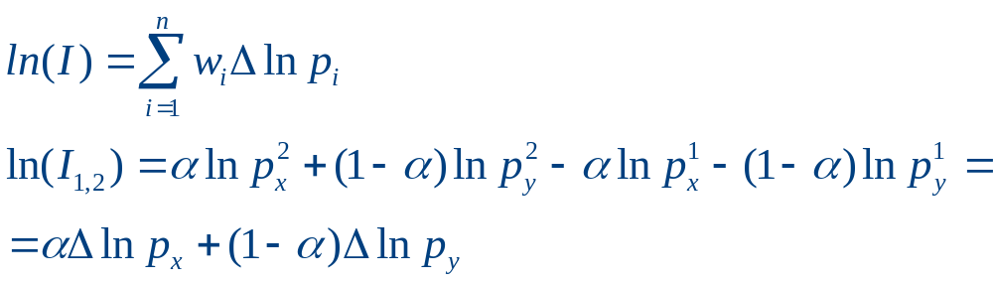
Development of exact price indices
The almost ideal demand system
  Implies an exact price index (I) that takes a ‘‘Divisia’’ form

